Slide 1
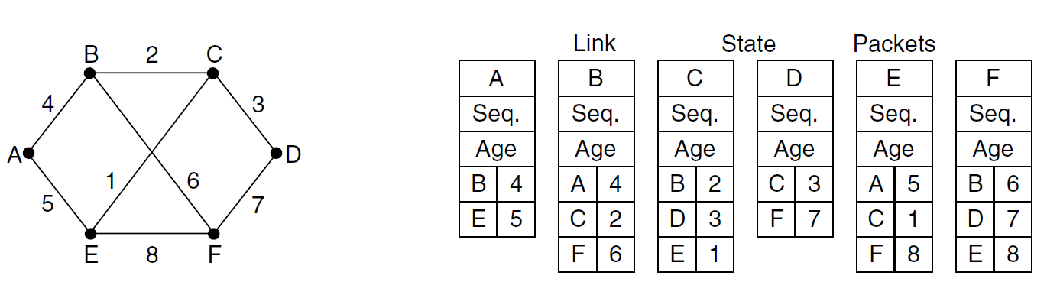
Link State Routing

Slide 2
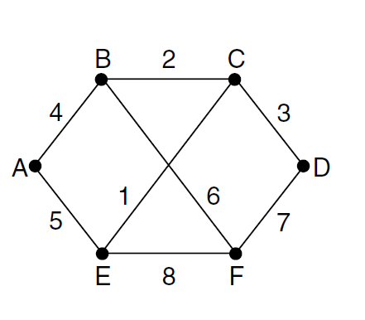
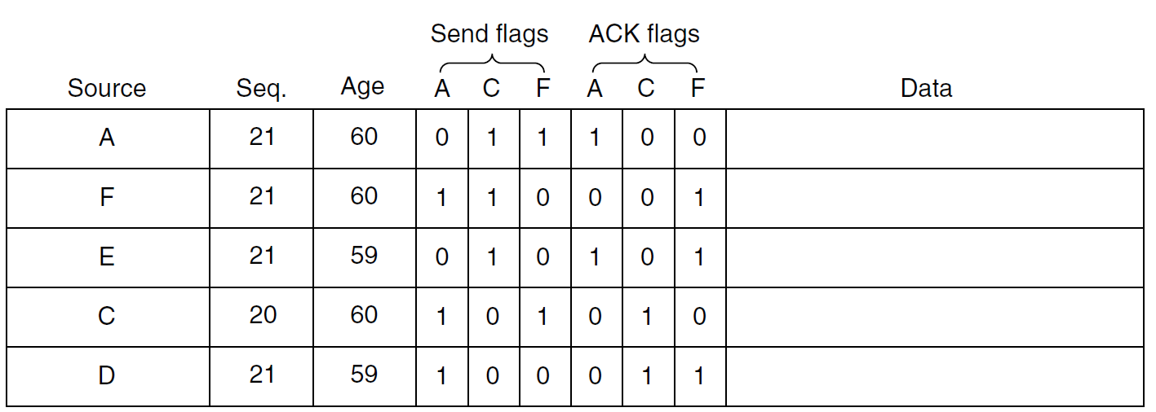
Link State Routing
Notes:
Host-specific
routing table for host SNext HopR1
R1
R1
R1DestinationA
B
C

Slide 3
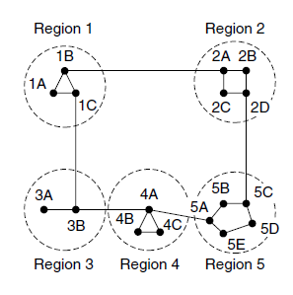
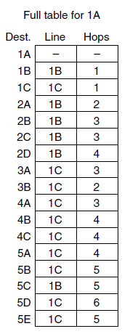
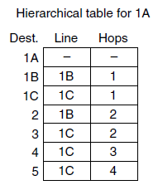
Hierarchical routing

Slide 4
Broadcast routing
Methods:
N-way Unicast
Uncontrolled Flooding
Controlled Flooding
  3.1. Seq number based
  3.2. Reverse path forwarding

Slide 5
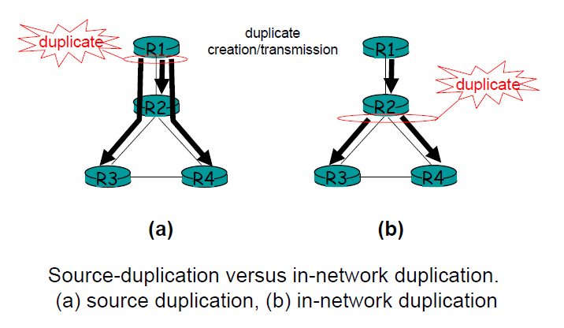
N-way Unicast

Slide 6
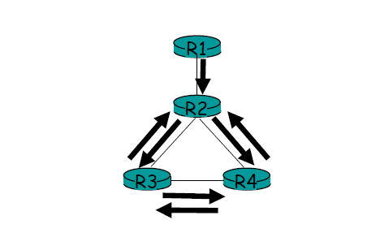
Uncontrolled Flooding

Slide 7
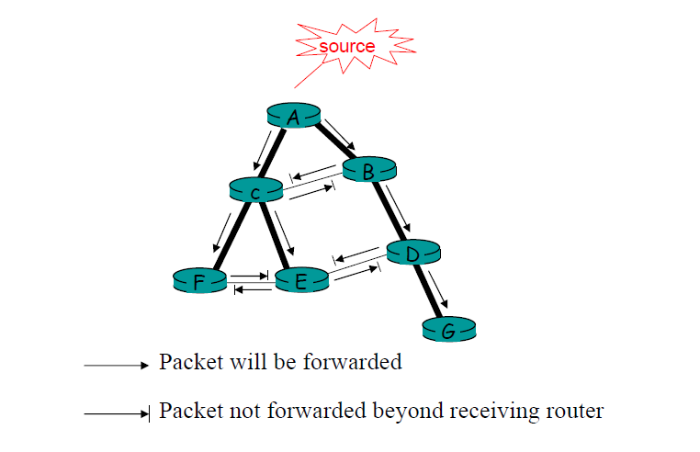
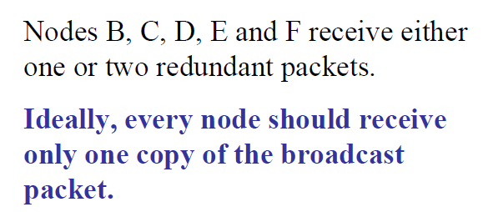
Controlled Flooding
Methods:
  1. Sequence number based
  2. Reverse path forwarding

Slide 8

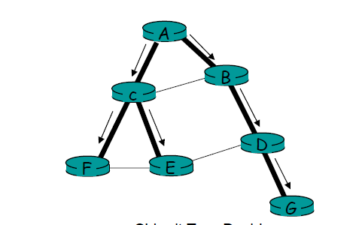
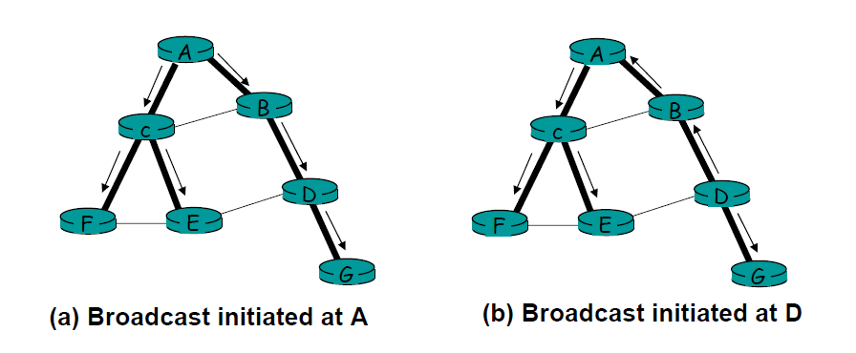

Slide 9
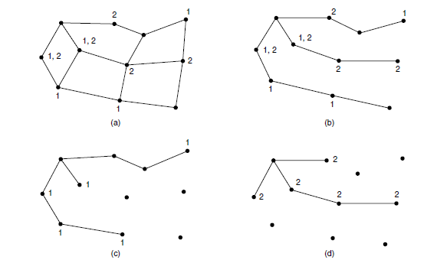
Multicast Routing
Methods:
Source based tree
Core based or Group shared tree
Source based tree

Slide 10
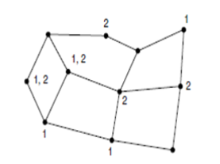
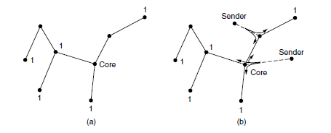
Multicast Routing
Core based or Group shared tree

